Slide 1

Expenses Tracker
Project Name
Submitted By -
﻿
Name - Pramod Sahu
Enrollment No- EBEON1122681503
Batch - 2022-8071
Date - 12/04/2023

Slide 2

Contents -
Introduction
Scope
Technology Used
Architecture of Projects
Spring Layered Architecture
Crud Operations
Screenshot of Home , View , Edit , Delete Page & Filter
Screenshot of Spring Boot Framework
Screenshoot of My SQL Database
Screenshot of Angular
GitHub Link
Thank You
﻿

Slide 3

Introduction
Daily Expense Tracker System is designed to keep a track of Expense of an organization or an Individual on a day-to-day basis. This System maintain the daily expenses. This Tracker will take input from user by add expenses tab and will show on page after that we can filter the expenses by their name , amount and short abbreviation and can delete the data .

Slide 4


Scope
Achieve your business goals with a tailored mobile app that perfectly fits your business.
Scale-up at the pace your business is growing.
Deliver an outstanding customer experience through additional control over the app.
Control the security of your business and customer data.
Open direct marketing channels with no extra costs with methods such as push notifications.

Slide 5






Technology Used

Slide 6
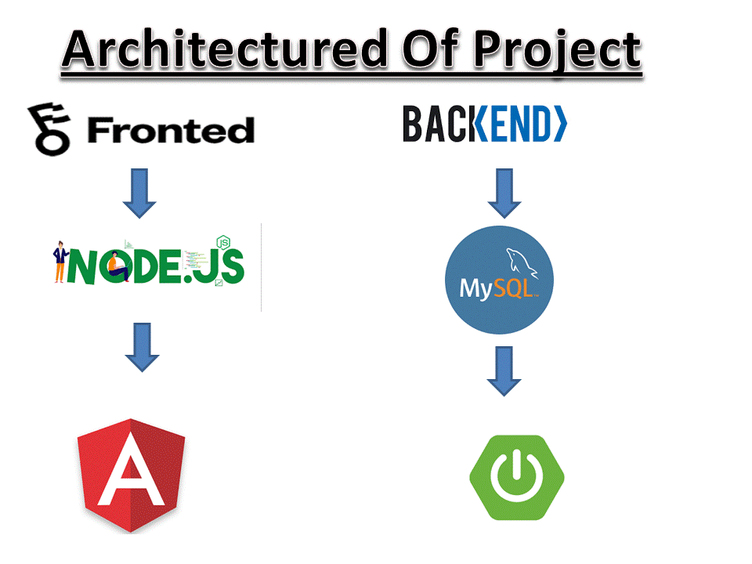

Slide 7
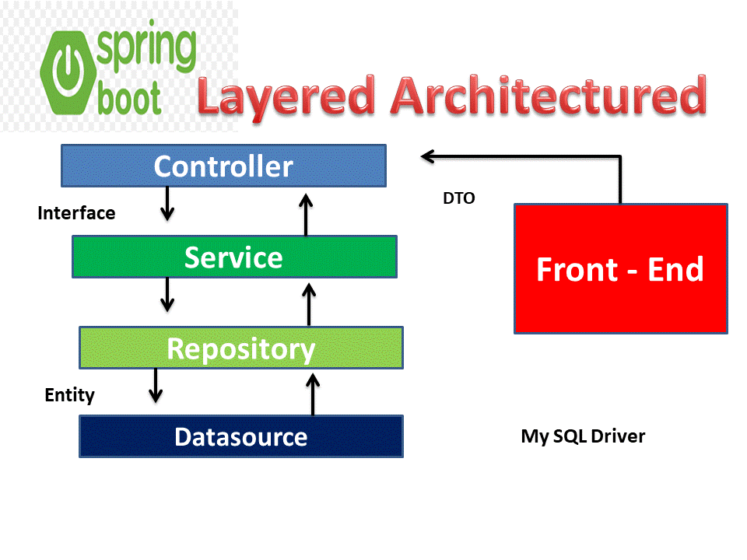

Slide 8
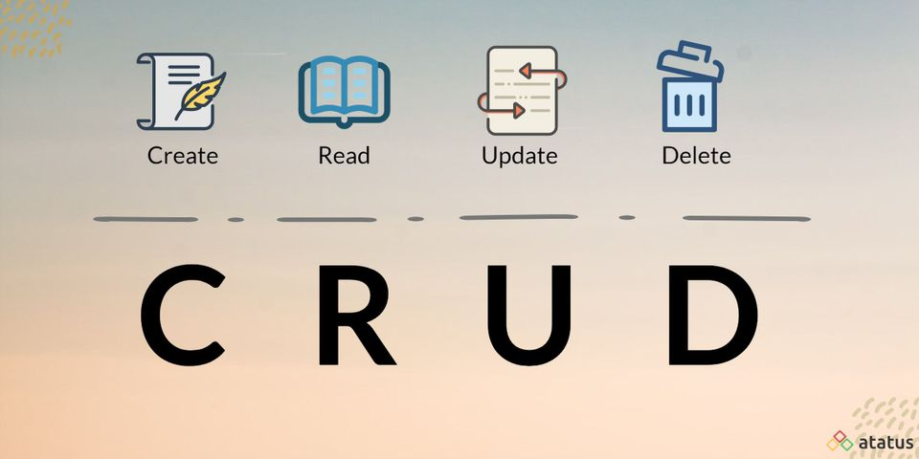

Slide 9
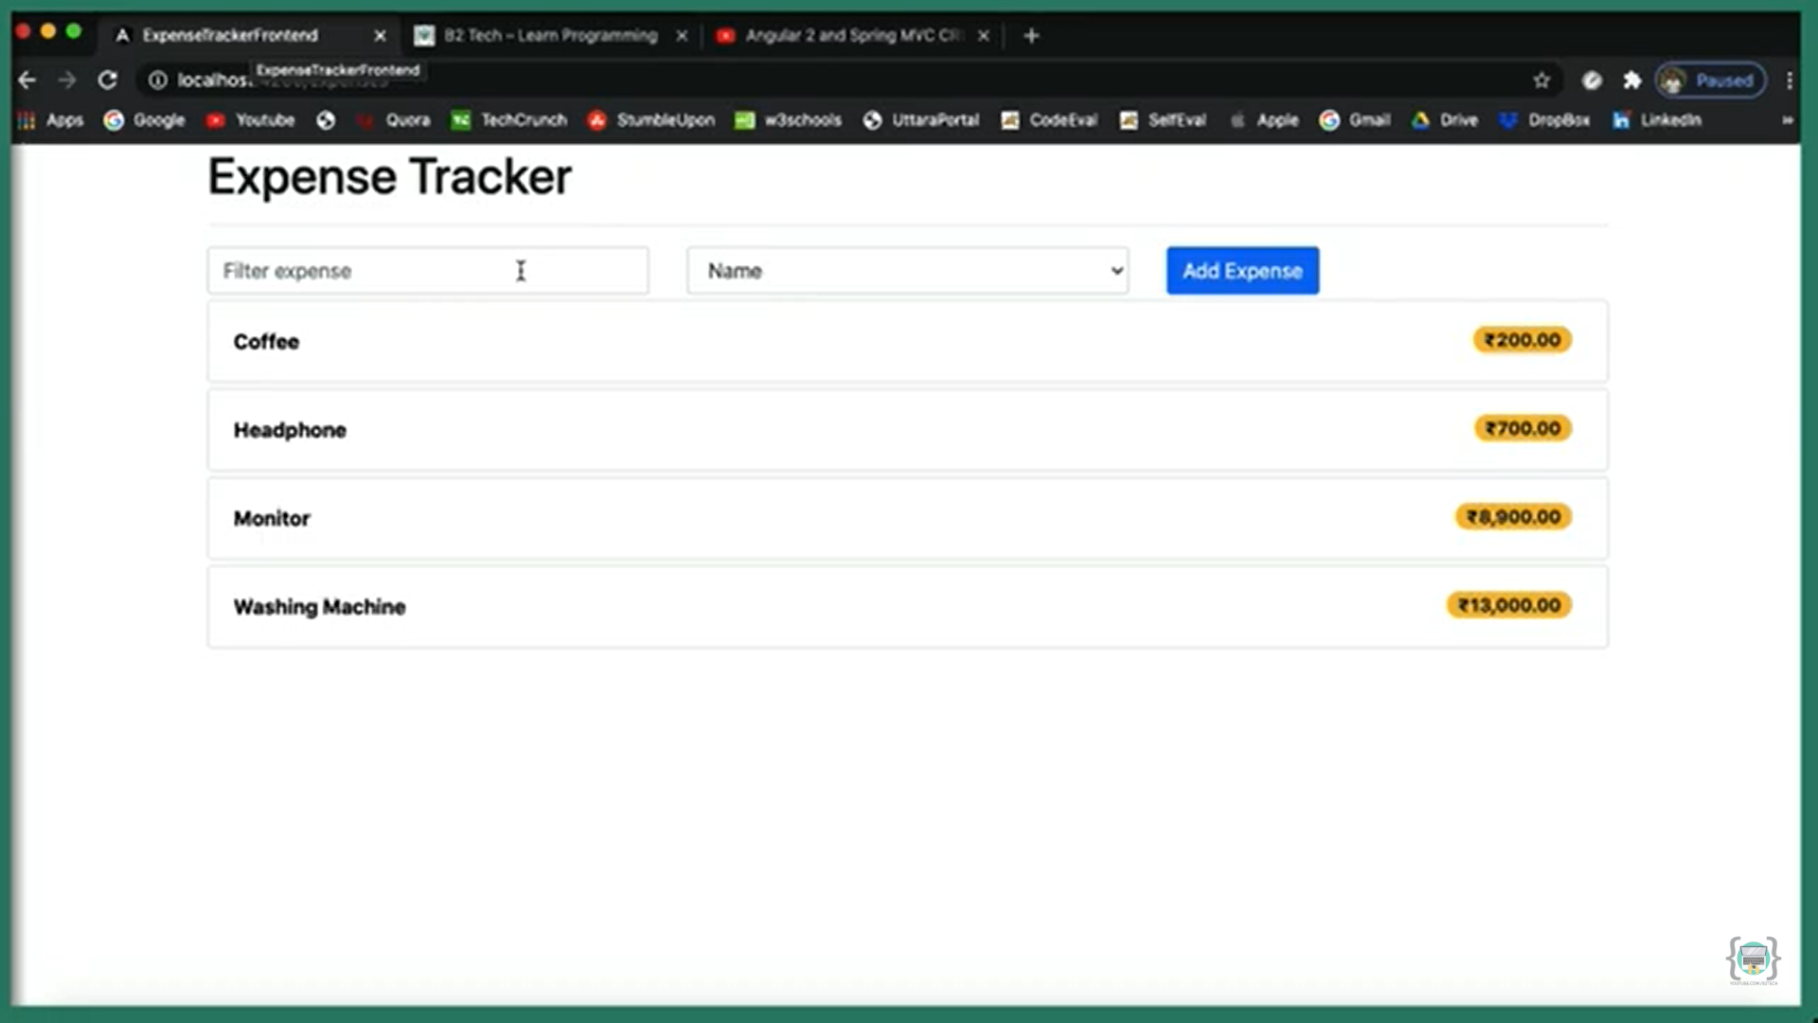
Screenshot of Home Page

Slide 10
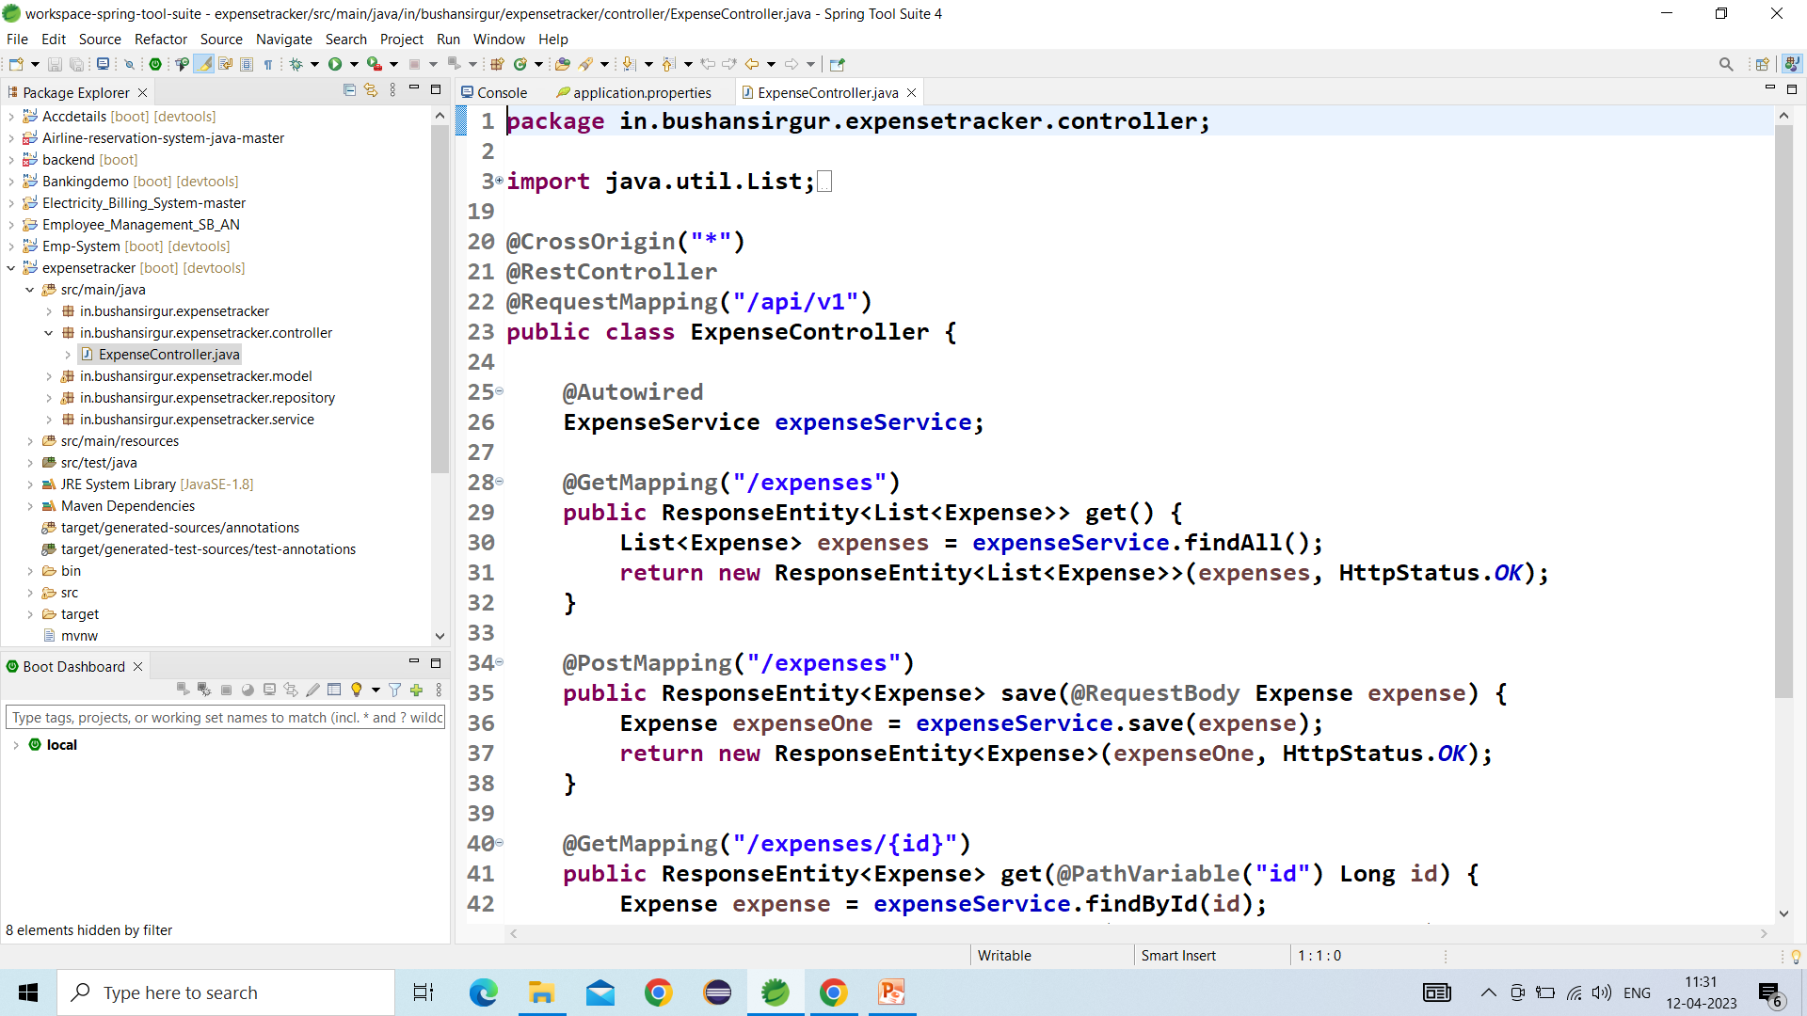
Screenshot of Spring Tool Suite

Slide 11
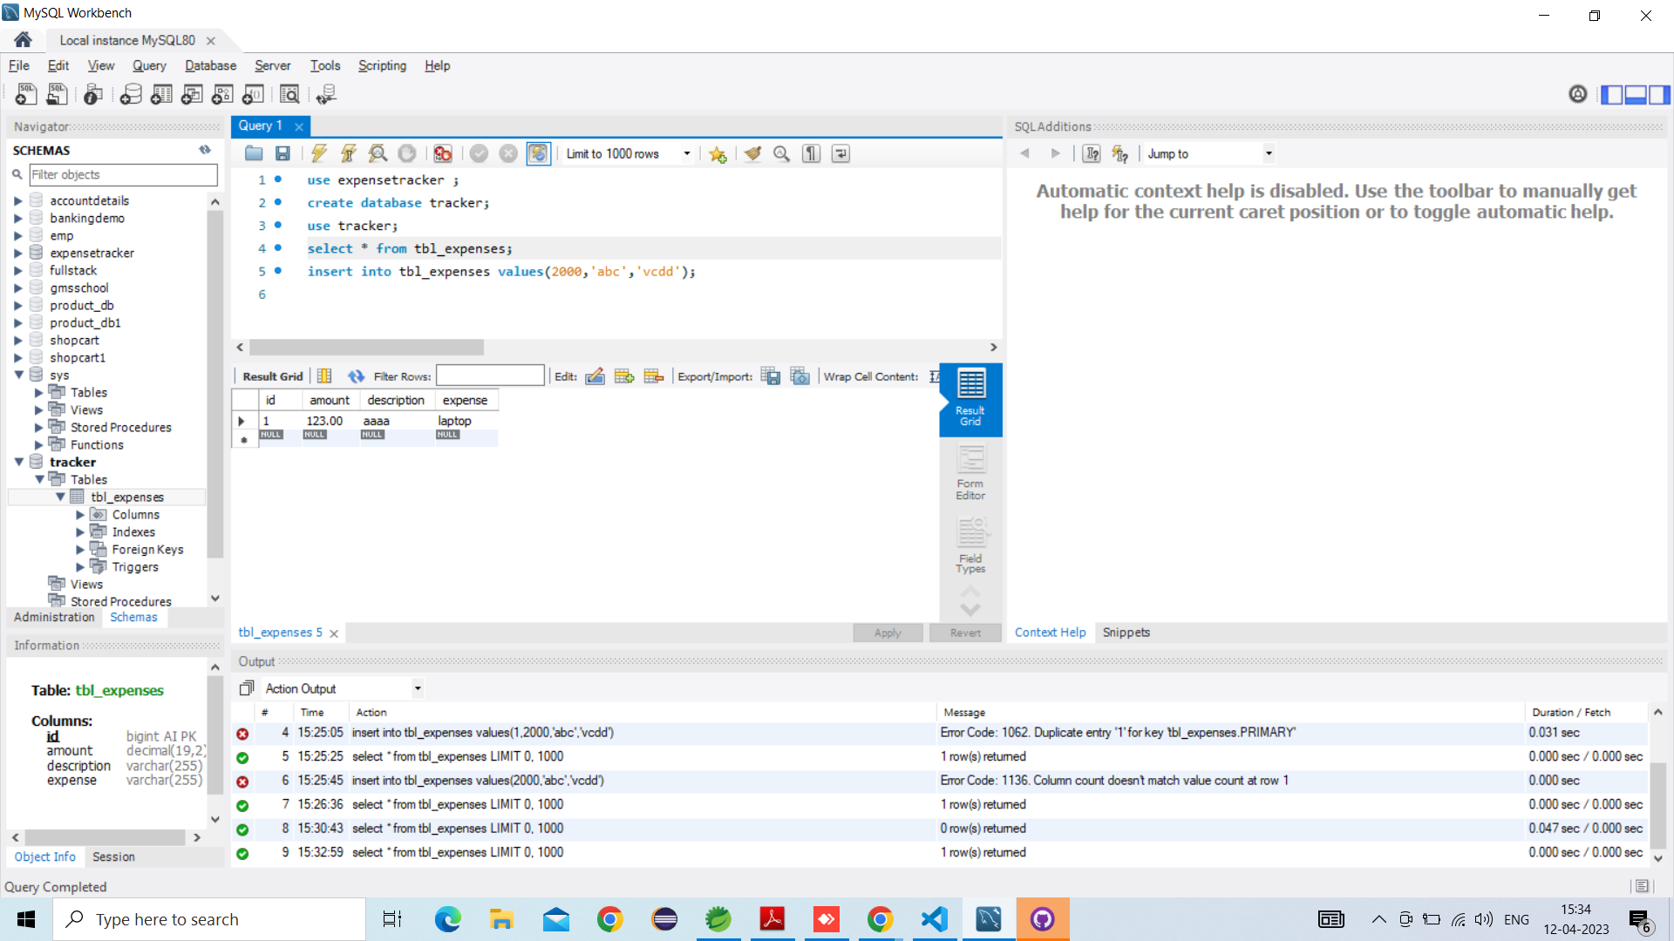
Screenshot of My SQL Database

Slide 12
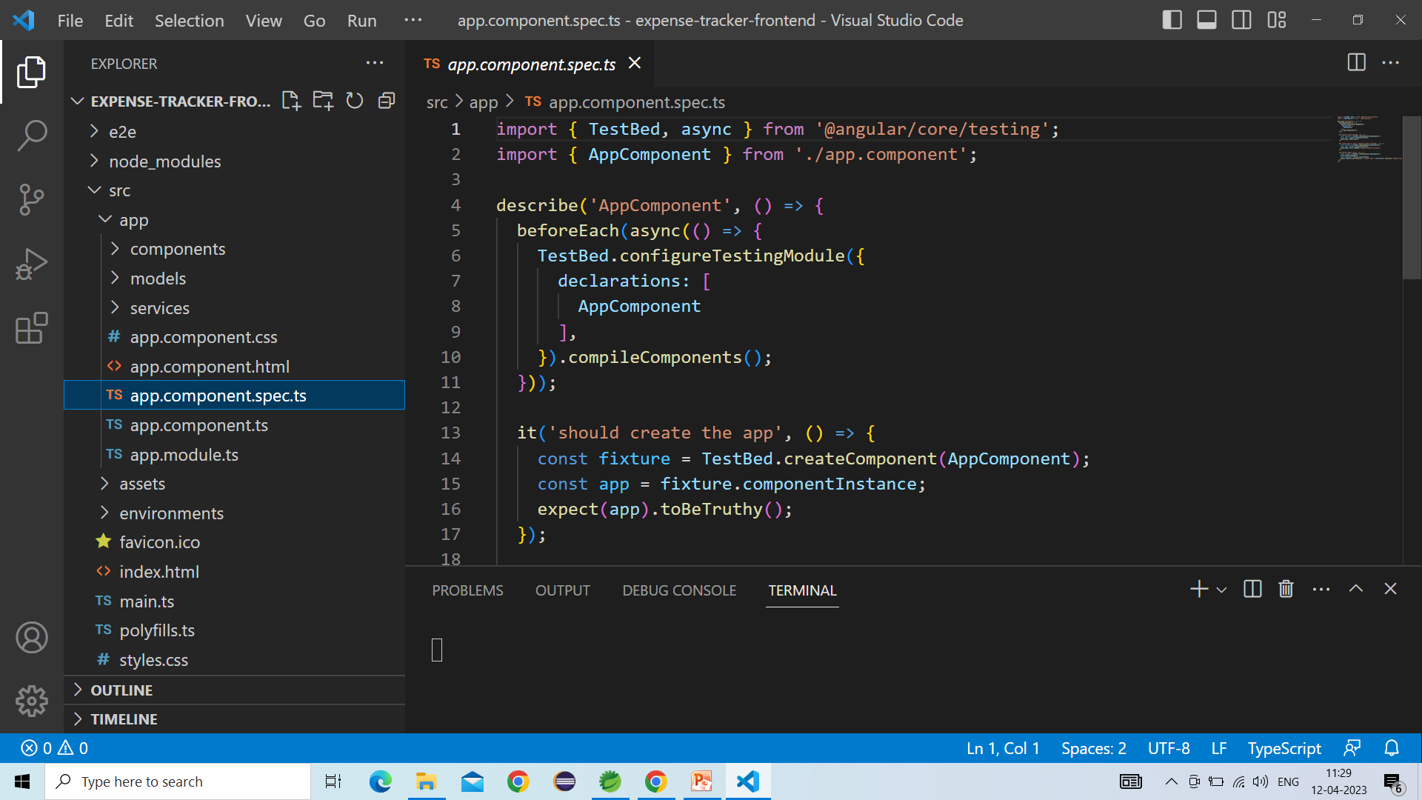
Screenshot of Angular

Slide 13
Screenshot of GitHub Link
https://github.com/Pramod06912/Pramod.git

Slide 14


